Slide 1


X
Insurance
agreement
GROUP 1
Fazeelat Sheikh, Tanglan Yang, Arielle Haslam,
Oskar Wahlberg, Alhasan Alqaraghuli
Notes:
Hi everyone, we're Group 1, and today I'll share our team project on Insurance Agreement, which we worked on with Wild West. Our main goal was to analyze insurance data so we could calculate commissions accurately and apply clawbacks.

Slide 2
OUTLINE
Data Preparation
Filtering the Eligible Policies
Data Cleaning
Calculate the Commissions
Calculating Clawbacks
Monthly Reports
Additional Analysis
Code
Notes:
To start, we cleaned up the data, filtering out only the policies that were eligible for commission. This helped us make sure we were only looking at valid policies. Then, we calculated commissions and clawbacks and created monthly reports for extra insights.

Slide 3



What We Used
DBeaver
Azure Data Studio
SSMS
PostgreSQL
Transact-SQL
Notes:
We used DBeaver, Azure Data Studio, PostgreSQL, and Transact-SQL to handle the data. We also set up a clear database structure to keep everything organized and make it easier to join data from different sources.

Slide 4
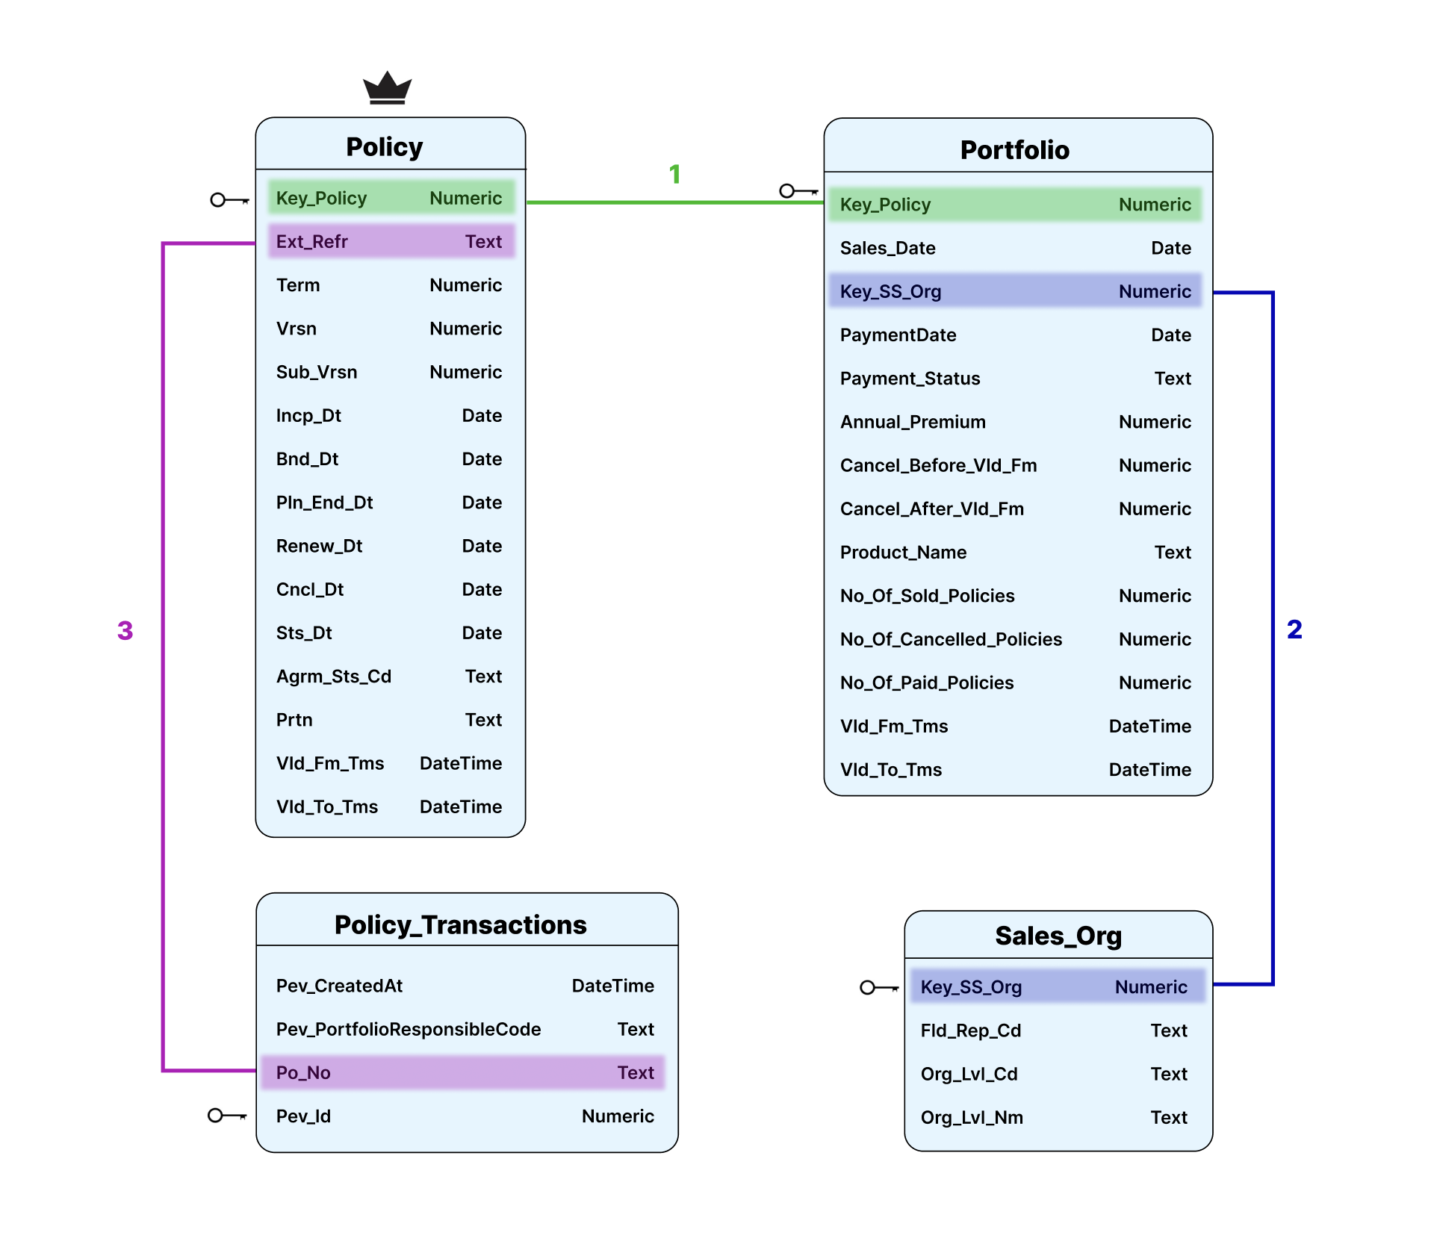
DATABASE schema
Notes:
When joining datasets, we considered all relevant columns and used SQL joins to connect everything efficiently. We then applied filters to narrow down to eligible policies, so our results were spot on.

Slide 5


Joining the data sets
DELETE
GRAB
Notes:
Now, Fazeelat will walk you through the next steps of our analysis.

Slide 6
FILTER ELIGIBLE POLICIES

Slide 7
Criteria 1
Portfolio Code should be WILDWEST-2 or WILDWEST-3.​
ext_refr = Policy Number
DELETE FROM ntrim
WHERE ext_refr IN
(SELECT ext_refr
FROM ntrim
WHERE pev_portfolioresponsiblecode
NOT IN ('WILDWEST-2','WILDWEST-3')
OR pev_portfolioresponsiblecode IS NULL);
SELECT po_No
FROM Policy_Transactions
WHERE Pev_PortfolioResponsibleCode IN ('WILDWEST-2', 'WILDWEST-3');ET-3'))

Slide 8
Criteria 2
Policy has been marked with the portfolio code for its entire duration
WITH a AS
(SELECT ext_refr ,
COUNT(DISTINCT pev_portfolioresponsiblecode)
FROM nall
GROUP BY ext_refr
HAVING COUNT (DISTINCT pev_portfolioresponsiblecode) >= 2)
DELETE FROM ntrim
WHERE ext_refr IN (SELECT ext_refr FROM a);
WITH Lags AS
(SELECT *,
LAG(pev_portfolioresponsiblecode, 1) OVER (PARTITION BY po_no ORDER BY key_policy, pev_id) AS lag
FROM dbo.PolicyandTransactions)
SELECT *
FROM Lags
WHERE lag <> pev_portfolioresponsiblecode

Slide 9
Criteria 3
The policy's payment status should indicate that the premium is paid
DELETE FROM ntrim
WHERE ext_refr IN
(SELECT ext_refr
FROM ntrim
WHERE payment_status = 'Not Paid');
SELECT key_policy
FROM dbo.portfolio
WHERE payment_status = 'Paid'

Slide 10
Criteria 4
Eligibility: (Product 1 to Product 8) & (Product 13 to Product 31)
DELETE FROM ntrim
WHERE ext_refr IN
(SELECT ext_refr
FROM ntrim
WHERE CAST(SUBSTRING(product_name, 8) AS INT) IN (9,10,11,12));
SELECT *
FROM dbo.portfolio
WHERE product_Name NOT IN ('Product 9', 'Product 10', 'Product 11', 'Product 12')

Slide 11
Criteria 5
Sales Channel: a. Outbound sales: portfolio code = ‘WILDWEST-3’
b. Internet Sales: portfolio code = ‘WILDWEST-3’
c. Inbound Sales: portfolio Code = ‘WILDWEST-2’
DELETE FROM ntrim
WHERE ext_refr IN (SELECT ext_refr
FROM ntrim
WHERE NOT (org_lvl_nm IN ('Outbound','Internet') AND pev_portfolioresponsiblecode = 'WILDWEST-3’)
AND NOT(org_lvl_nm = 'Inbound’ AND pev_portfolioresponsiblecode ='WILDWEST-2' ));
SELECT *
FROM dbo.Sales_Org WHERE ((Org_Lvl_Nm IN ('Internet','Outbound') AND PT.Pev_PortfolioResponsibleCode = 'WILDWEST-3')
OR (Org_Lvl_Nm = 'Inbound' AND PT.Pev_PortfolioResponsibleCode = 'WILDWEST-2'))

Slide 12
Errors FOUND + assumptions MADE
-
Data cleaning to remove null values and fix errors
Update the table
3. Policies with multiple versions. Consider the ones with available data 4. Instances with multiple annual premiums NOT an error in data
5. We pay commission for the whole year the month following the payment of the policy
UPDATE ntrim SET annual_premium = LEFT (annual_premium,POSITION (',' IN annual_premium) - 1);​
ALTER TABLE pro.ntrim ALTER COLUMN annual_premium TYPE INT4 USING annual_premium::INT4;

Slide 13
CALCULATE COMMISSIONS
CREATE TABLE temp_ntrim AS
( THE STATEMENT)
DROP TABLE ntrim;
SELECT * INTO ntrim FROM temp_ntrim;
DROP TABLE temp_ntrim;
CREATE TABLE temp_ntrim AS
( THE STATEMENT)
DROP TABLE ntrim;
ALTER TABLE temp_ntrim RENAME TO ntrim ;
OR
Notes:
I’m going to walk us through how we calculated commissions.
So, as you saw before, when working in Postgres, we combined everything and then trimmed it down. The code here shows the framework we used when calculating commission, which was to create a table called temp_ntrim with the queries that will be shown in the following slides, then we dropped the original table, ntrim – next we took all the values of the temporary table and inserted them into a newer table (recycling the name ntrim) and then dropped the temp table.
The reason for this was technical limitations in Postgres. We couldn’t just alter the table to add a column to it. (We recycled the name of the table to keep track of where everything was).
(Here is a depiction of that.)

Slide 14
COMMISSION STRUCTURE
First 1500 eligible policies: 12% of the Annual_Premium F 1501st policy onwards: 14% of the Annual_Premium
SELECT
MAX(pln_end_dt) OVER(PARTITION BY ext_refr) - incp_dt AS days_valid,
*
FROM ntrim;
Days valid = days the policy should be active and paid per the agreement
Notes:
We started by calculating the number of days that the policy was originally valid for. We got the number of days by selecting the maximum planned end date and subtracted the inception date. We needed the maximum end date because if a policy was canceled the planned end date would update to the date of cancellation, so this way we are only selecting the original end date, per the sale of the policy. We partitioned by the policy number so that we wouldn't be counting the same policy more than once.

Slide 15
COMMISSION STRUCTURE
WITH a AS
(SELECT ext_refr AS ext_ref, row_number() OVER(ORDER BY MIN(paymentdate), MIN(sales_date))
FROM ntrim
GROUP BY ext_ref)
SELECT *
FROM ntrim AS n
LEFT JOIN a
ON n.ext_refr = a.ext_ref;
Notes:
Next we wanted to order the policies that earn commission so we could know if they should be paid at 12% or 14%. We did this by assigning a unique row number to each unique policy number. The way we determined the row number was to order the results by payment date – we decided that the first policy to get paid is the first policy, so row # 1. After payment date we ordered by sales date to act as a tie-breaker for instances where multiple policies were paid on the same day. This matters when we get the 1501st policy – it determines which policy is paid at 12% and which at 14%.
That is this select statement in the with clause. To ensure that every row for each policy was assigned the same row number we grouped these results by policy number. However, this aggregates the data for each policy into one row and we wanted to look at every row of data pertaining to the policies, so we did a self-join on policy number.

Slide 16
COMMISSION STRUCTURE
SELECT CASE
WHEN row_number >= 1501
THEN annual_premium * 0.14 * (days_valid - extract (DAY FROM date_trunc ( 'day', vld_fm_tm - incp_dt))) / days_valid
ELSE annual_premium * 0.12 * (days_valid - extract (DAY FROM date_trunc ('day', vld_fm_tm -
incp_dt))) / days_valid END AS revenue,
*
FROM ntrim;
Notes:
This slide shows the code that calculates the commission percentage. We used a case statement to assign a 14% or 12% commission rate, depending on that row number that we assigned in the code shown in the previous slide.
In this case statement we are also calculating the amount of commission that gets paid for each policy, which was the annual premium times the commission rate times the number of days that are eligible for commission.
The time we are counting is for that particular version until the end date, so if, for example, there was another version of the policy before, those days with that earlier version are removed.
The results will be shown by Hasan, after he walks us through the code used to calculate clawbacks.
Inception day: bc that's the beginning of valid period, and they have up to 3 months to pay
Math notes:
Measuring percentage on year – we want days, so we divide the year into days
Instead of 365, we chose to make the code "conform" to the needs of that policy, this way we eliminate errors – for example, using 365 doesn't take leap years into account.

Slide 17
Calculate clawback

Slide 18
CLawback
SELECT CASE
WHEN agrm_sts_cd = 'ACTIVE’
THEN date_trunc('day', vld_to_tm - vld_fm_tm)
ELSE date_trunc('day', MAX(pln_end_dt) OVER(PARTITION BY
ext_refr) - vld_fm_tm) END AS time,
*
FROM ntrim;
Notes:
For version changes, we are calculating the difference between the day form which the version was valid until it was supposed to end, then we truncate it down to keep year month and day
Otherwise if it was cancelled (the policy) then we take the planned end date for all versions and subtract from it the start date to calculate the clawback

Slide 19
CLawback
SELECT CASE
WHEN DATE (vld_to_tm) <> rnew_dt THEN revenue –
EXTRACT (DAY FROM TIME) / days_valid * revenue
WHEN cncl_dt IS NOT NULL THEN EXTRACT (DAY FROM TIME) / days_valid * revenue
ELSE NULL END AS claw,
*
FROM ntrim;
Notes:
Additional analysis to capture cancelled policies. Renewal date is not equal to the valid to date + cancellation date is there but policy not marked as cancelled

Slide 20
CLawback
ALTER TABLE ntrim
ADD COLUMN claw_month date;
UPDATE ntrim SET claw_month = CASE
WHEN claw > 0 AND agrm_sts_cd = 'ACTIVE’
THEN DATE_TRUNC ('Month', vld_to_tm)
WHEN agrm_sts_cd = 'CANCEL’
THEN DATE_TRUNC ('Month', cncl_dt)
ELSE NULL END;

Slide 21
REPORTING

Slide 22
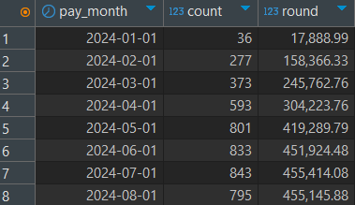
MONTHLY AGGREGATION
Group the data by month and sum the commissions for each month
SELECT pay_month,
COUNT (*),
ROUND (SUM(revenue) , 2)
FROM ntrim
GROUP BY pay_month
ORDER BY 1;

Slide 23
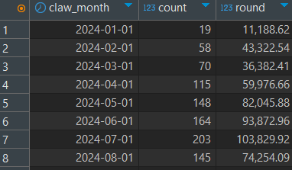
MONTHLY AGGREGATION
Group the data by month and sum the clawback for each month
SELECT claw_month,​​
COUNT (*),​​
ROUND (SUM (claw) , 2)​​
FROM ntrim​​
GROUP BY claw_month​​
ORDER BY 1;

Slide 24
ADDITIONAL ANAYLSIS

Slide 25
General CODE BY AGENT
Note: strim is a table like ntrim but
Ignores if it’s paid to get all sales
WITH A AS
(SELECT fld_rep_cd AS fld_a,
COUNT (*) AS salec_month,
ROUND (AVG (revenue),2) AS saleavg_month,
ROUND (SUM (revenue),2) AS salesum_month
FROM strim
WHERE sale_month = '2024-02-01' -- CHANGE THIS TO CURRENT MONTH
GROUP BY fld_rep_cd)
,B AS
(SELECT fld_rep_cd AS fld_b,
COUNT (*) AS paidc_year,
ROUND (AVG (revenue),2) AS paidavg_year,
ROUND (SUM (revenue),2) AS paidsum_year
FROM ntrim
WHERE pay_month <= '2024-02-01'-- CHANGE THIS TO CURRENT MONTH
GROUP BY fld_rep_cd)

Slide 26
General CODE BY AGENT
,C AS
(SELECT fld_rep_cd AS fld_c,
COUNT (*) AS salec_year,
ROUND (SUM (revenue) , 2) AS salesum_year,
ROUND (AVG (EXTRACT (MONTH FROM sale_month)) , 2) AS avgsalemonth
FROM strim
WHERE sale_month <= '2024-02-01' -- CHANGE THIS TO CURRENT MONTH
GROUP BY fld_rep_cd)
,D AS
(SELECT fld_rep_cd AS fld_D,
COUNT (*) AS clawc_year,
ROUND (SUM (claw) , 2) AS clawsum_year
FROM strim
WHERE claw_month <= '2024-02-01' -- CHANGE THIS TO CURRENT MONTH
GROUP BY fld_rep_cd)

Slide 27
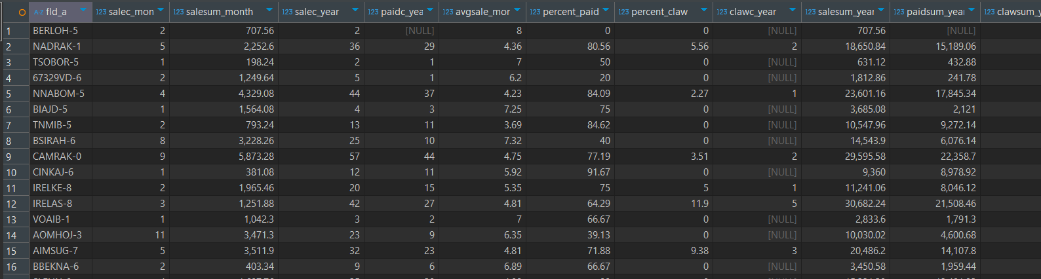
General CODE BY AGENT
SELECT fld_a,
salec_month,
salesum_month,
salec_year,
avgsalemonth,
paidc_year,
ROUND ((paidc_year*100.0) / (salec_year),2) AS percent_paid,
ROUND ((clawc_year*100.0) / (salec_year),2) AS percent_cancel,
clawc_year,
salesum_year,
paidsum_year,
clawsum_year
FROM a
LEFT JOIN b
ON a.fld_a = b.fld_b
LEFT JOIN C
ON a.fld_a = c.fld_c
LEFT JOIN D
ON a.fld_a = d.fld_d
ORDER BY 3 DESC;

Slide 28
Top sales by AGENT
WITH a AS
(SELECT fld_rep_cd AS fld_a,
ROUND(SUM(revenue),2) AS salesum_month
FROM strim
WHERE sale_month ='2024-08-01' -- CHANGE THIS TO CURRENT MONTH
GROUP BY fld_rep_cd)
SELECT fld_a,
salesum_month
FROM a
ORDER BY 2 DESC
LIMIT 5;

Slide 29
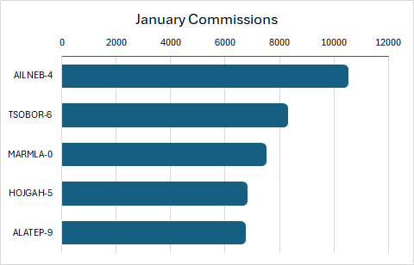
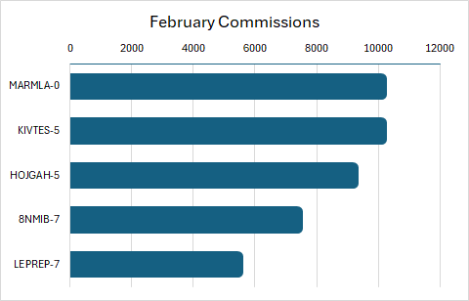
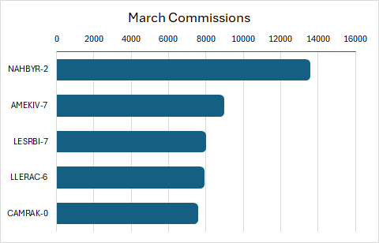
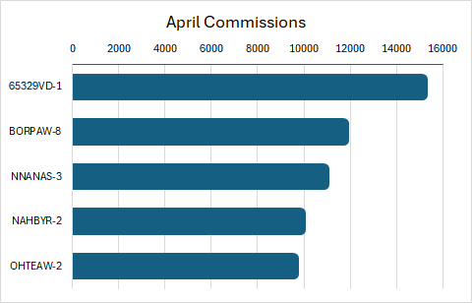
Top sales in jan-apr

Slide 30
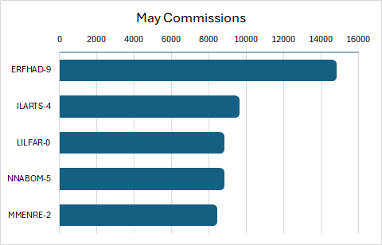
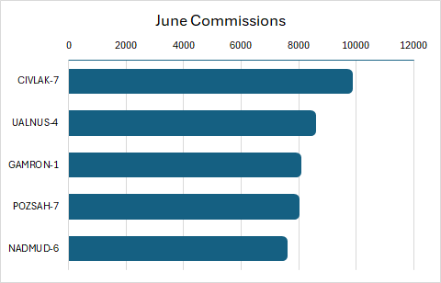
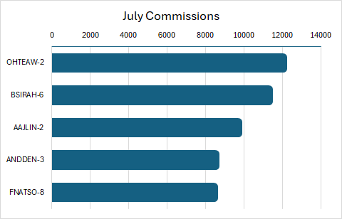
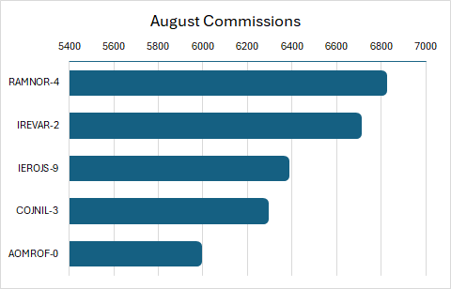
Top sales in may-aug

Slide 31

TOTal cancelations
WITH a AS
(SELECT COUNT(*) AS clawc_year
FROM strim
WHERE claw_month <='2024-08-01’
AND agrm_sts_cd='CANCEL')
,b AS
(SELECT COUNT(DISTINCT (ext_refr)) AS salec_year
FROM strim
WHERE sale_month <='2024-08-01’)
SELECT (SELECT clawc_year FROM a),
salec_year,
ROUND((SELECT clawc_year*100.0 FROM a)/salec_year,2)
FROM b

Slide 32
Cancellations by agent
WITH a AS
(SELECT fld_rep_cd AS fld_a,
COUNT(*) AS salec_year,
ROUND(SUM(revenue),2) AS salesum_year,
FROM strim
WHERE sale_month <='2024-08-01'-- CHANGE THIS TO CURRENT MONTH
GROUP BY fld_rep_cd)
,b AS
(SELECT fld_rep_cd AS fld_b,
COUNT(*) AS clawc_year,
ROUND(SUM(claw),2) AS clawsum_year
FROM strim
WHERE claw_month <='2024-08-01’
AND agrm_sts_cd='CANCEL'-- CHANGE THIS TO CURRENT MONTH
GROUP BY fld_rep_cd)

Slide 33
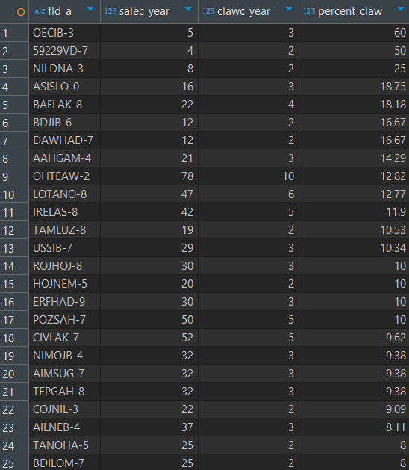
Cancellations by agent
SELECT fld_a,
salec_year,
clawc_year,
COALESCE(ROUND((clawc_year*100.0)/
(salec_year),2),0) AS percent_CLAW
FROM a
LEFT JOIN b
ON a.fld_a = b.fld_b
WHERE COALESCE (ROUND((clawc_year*100.0)/ (salec_year),2),0) > 5
AND clawc_year > 1
ORDER BY 4 DESC;

Slide 34
Incomplete data
Incomplete information from WILD WEST in Portfolio Table
Policy table
Portfolio table

Slide 35

Thank you! Ready for some action now?
A few stats
QR-Code to Code
Total just ntrim
Words: 750
Lines of code: 159
Amount of instruction: 59
Total
Words: 1596
Lines of code: 406
Amount of instruction: 102
https://docs.google.com/document/d/1EuJUrT62Aa-aqjN3wAUetQgx2_L597lA68oW8wTw6kw

Slide 36
DATA PREPARATION
GRAB
DELETE

Slide 40
Insurance agreement with Wild West AB
Fazeelat Sheikh, Tanglan Yang, Arielle Haslam,
Oskar Wahlberg, Alhasan Alqaraghuli

Slide 41
X
Insurance
agreement
Insurance agreement between Hyper Insurance and Wild West AB
with monthly KPI’s

Slide 42
Joining the data sets
ALTER TABLE sales_org RENAME COLUMN key_ss_org TO key_ss_or;
ALTER TABLE policy RENAME COLUMN key_policy TO key_polic;
ALTER TABLE policy RENAME COLUMN vld_fm_tms TO vld_fm_tm;
ALTER TABLE policy RENAME COLUMN vld_to_tms TO vld_to_tm;
CREATE TABLE ntrim AS
SELECT *
FROM policy AS p3
LEFT JOIN portfolio AS p1
ON p1.key_policy = p3.key_polic
LEFT JOIN sales_org AS p2
ON p2.key_ss_or = p1.key_ss_org
LEFT JOIN policy_transactions AS p4
ON p4.po_no = p3.ext_refr;

Slide 43
COMMISSION STRUCTURE
First 1500 eligible policies: 12% of the Annual_Premium F 1501st policy onwards: 14% of the Annual_Premium
SELECT
YEAR(PaymentDate) AS Year,
MONTH(PaymentDate) AS Month,
COUNT(*) AS Total_Policies,
SUM(CASE
WHEN PolicyRank <= 1500 THEN Annual_Premium * 0.12
ELSE Annual_Premium * 0.14
END) AS Total_Commission
FROM EligiblePolicies
WHERE YEAR(PaymentDate)=2024 AND
MONTH(PaymentDate)BETWEEN 1 AND 8
GROUP BY YEAR(PaymentDate), MONTH(PaymentDate)
ORDER BY Year, Month;

Slide 44
Joining the data sets
LEFT JOIN Portfolio po ON p.Key_Policy = po.Key_Policy
LEFT JOIN Policy_Transactions pt ON p.Ext_Refr = pt.Po_No
LEFT JOIN Sales_Org so ON po.Key_SS_Org = so.Key_SS_Org

Slide 46
What We Used
DBeaver - Postgres
Azure Data Studio ​
MS-SQL

Slide 48
Data cleaning
To remove errors
DELETE FROM ntrim
WHERE ext_refr IN (SELECT ext_refr
FROM ntrim
WHERE sales_date > paymentdate);
DELETE FROM ntrim
WHERE sales_date >= '2024-09-01';
DELETE FROM ntrim
WHERE pay_month >= '2024-09-01';
UPDATE ntrim SET annual_premium = left (annual_premium,position (',' IN annual_premium) - 1);
ALTER TABLE pro.ntrim ALTER COLUMN annual_premium TYPE int4 USING annual_premium::int4;

Slide 49
ASSUMPTIONS
- We have a big number of policies (around 600) with multiple versions and there is no data there for products and status of these policies BUT we can’t ignore this so we will take them into account and assume that they are paid til they’re officially cancelled.
- We want it to be Wildwest-2 or Wildwest-3 from the start til end, if anything else we dont take it into account. - 4 rows with multiple annual premium. We take that as a change in annual premium and NOT an error in data. Suggestion: Maybe take up as potential additional analysis to fix!
- We pay commission for the whole year the month following the sale, same for clawbacks!

